Slide 1
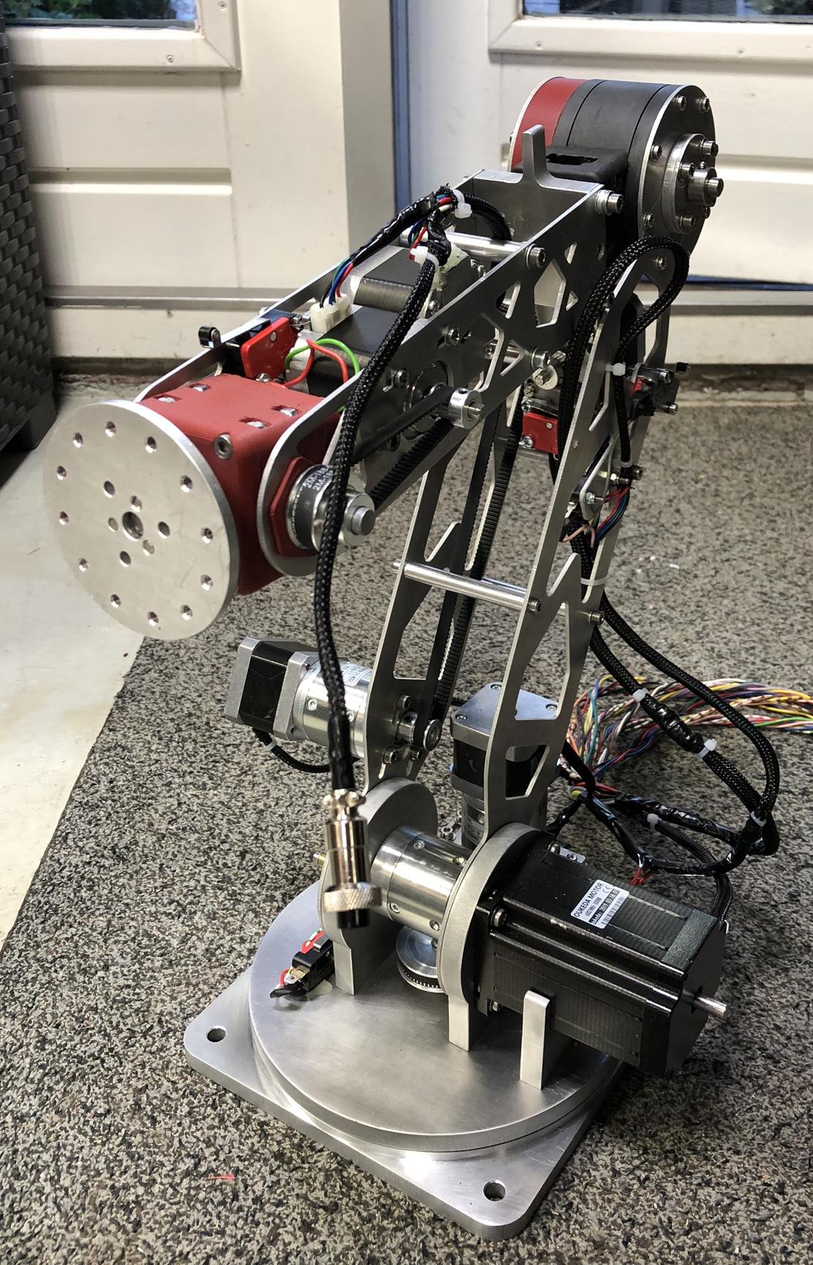
6 – Axis robot arm
Stefan, Sven & Thijs

Slide 2
Table of content
Wiring
Movement
Planning

Slide 3
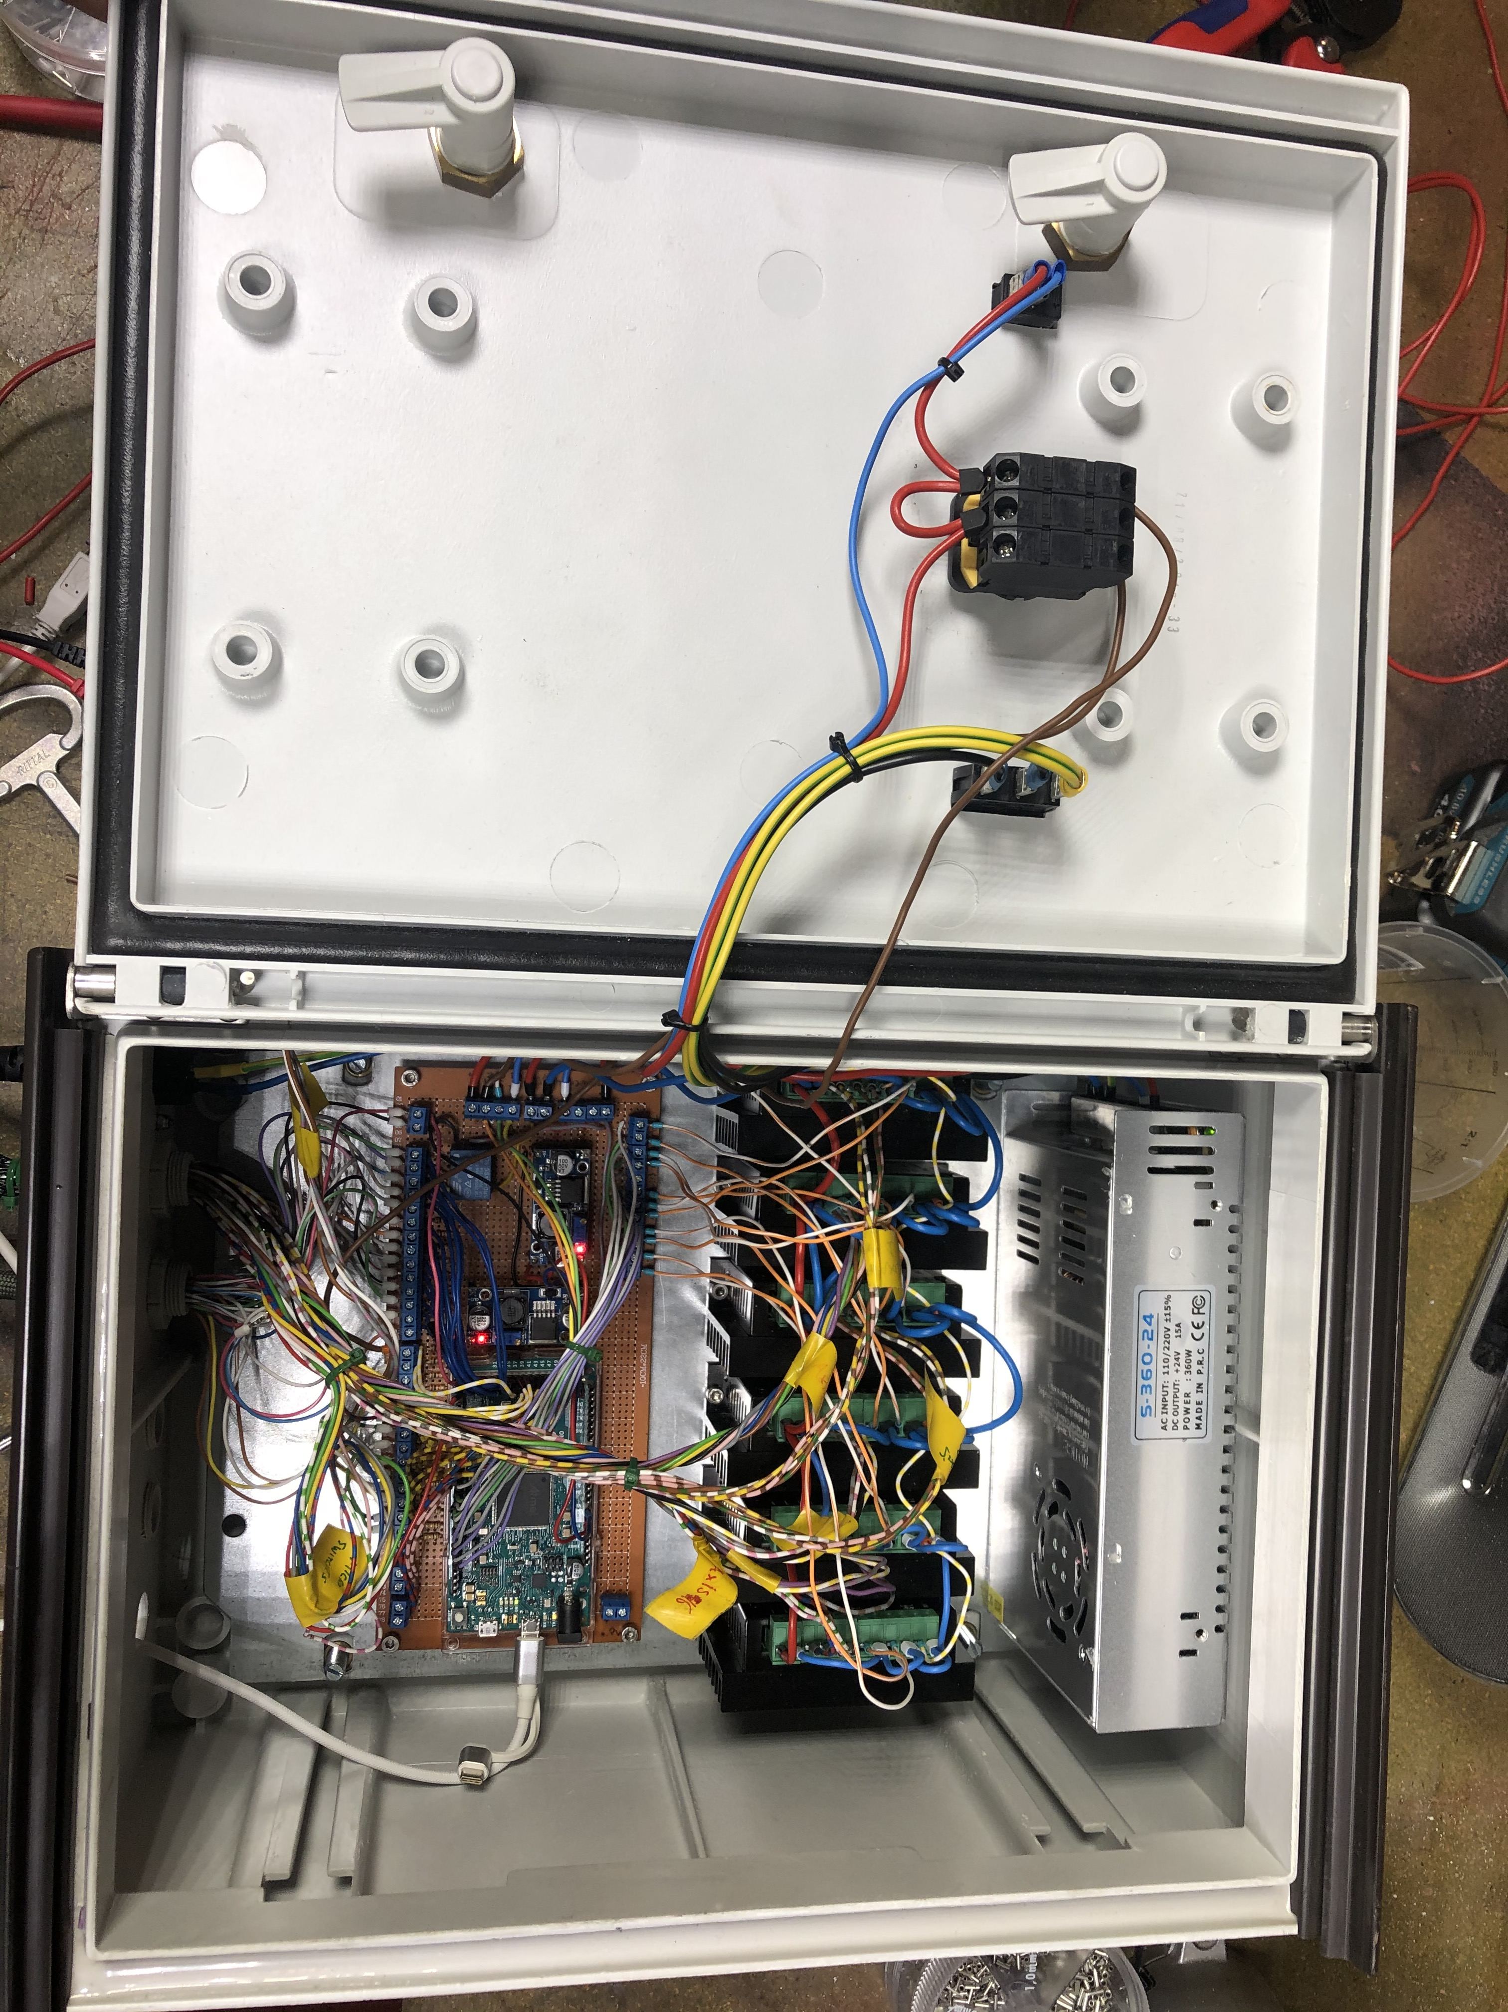
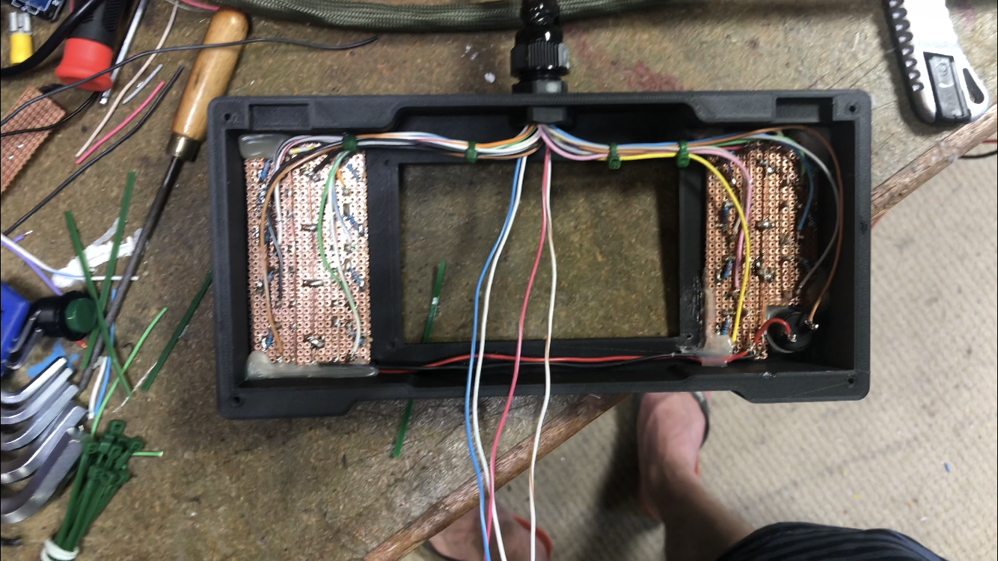
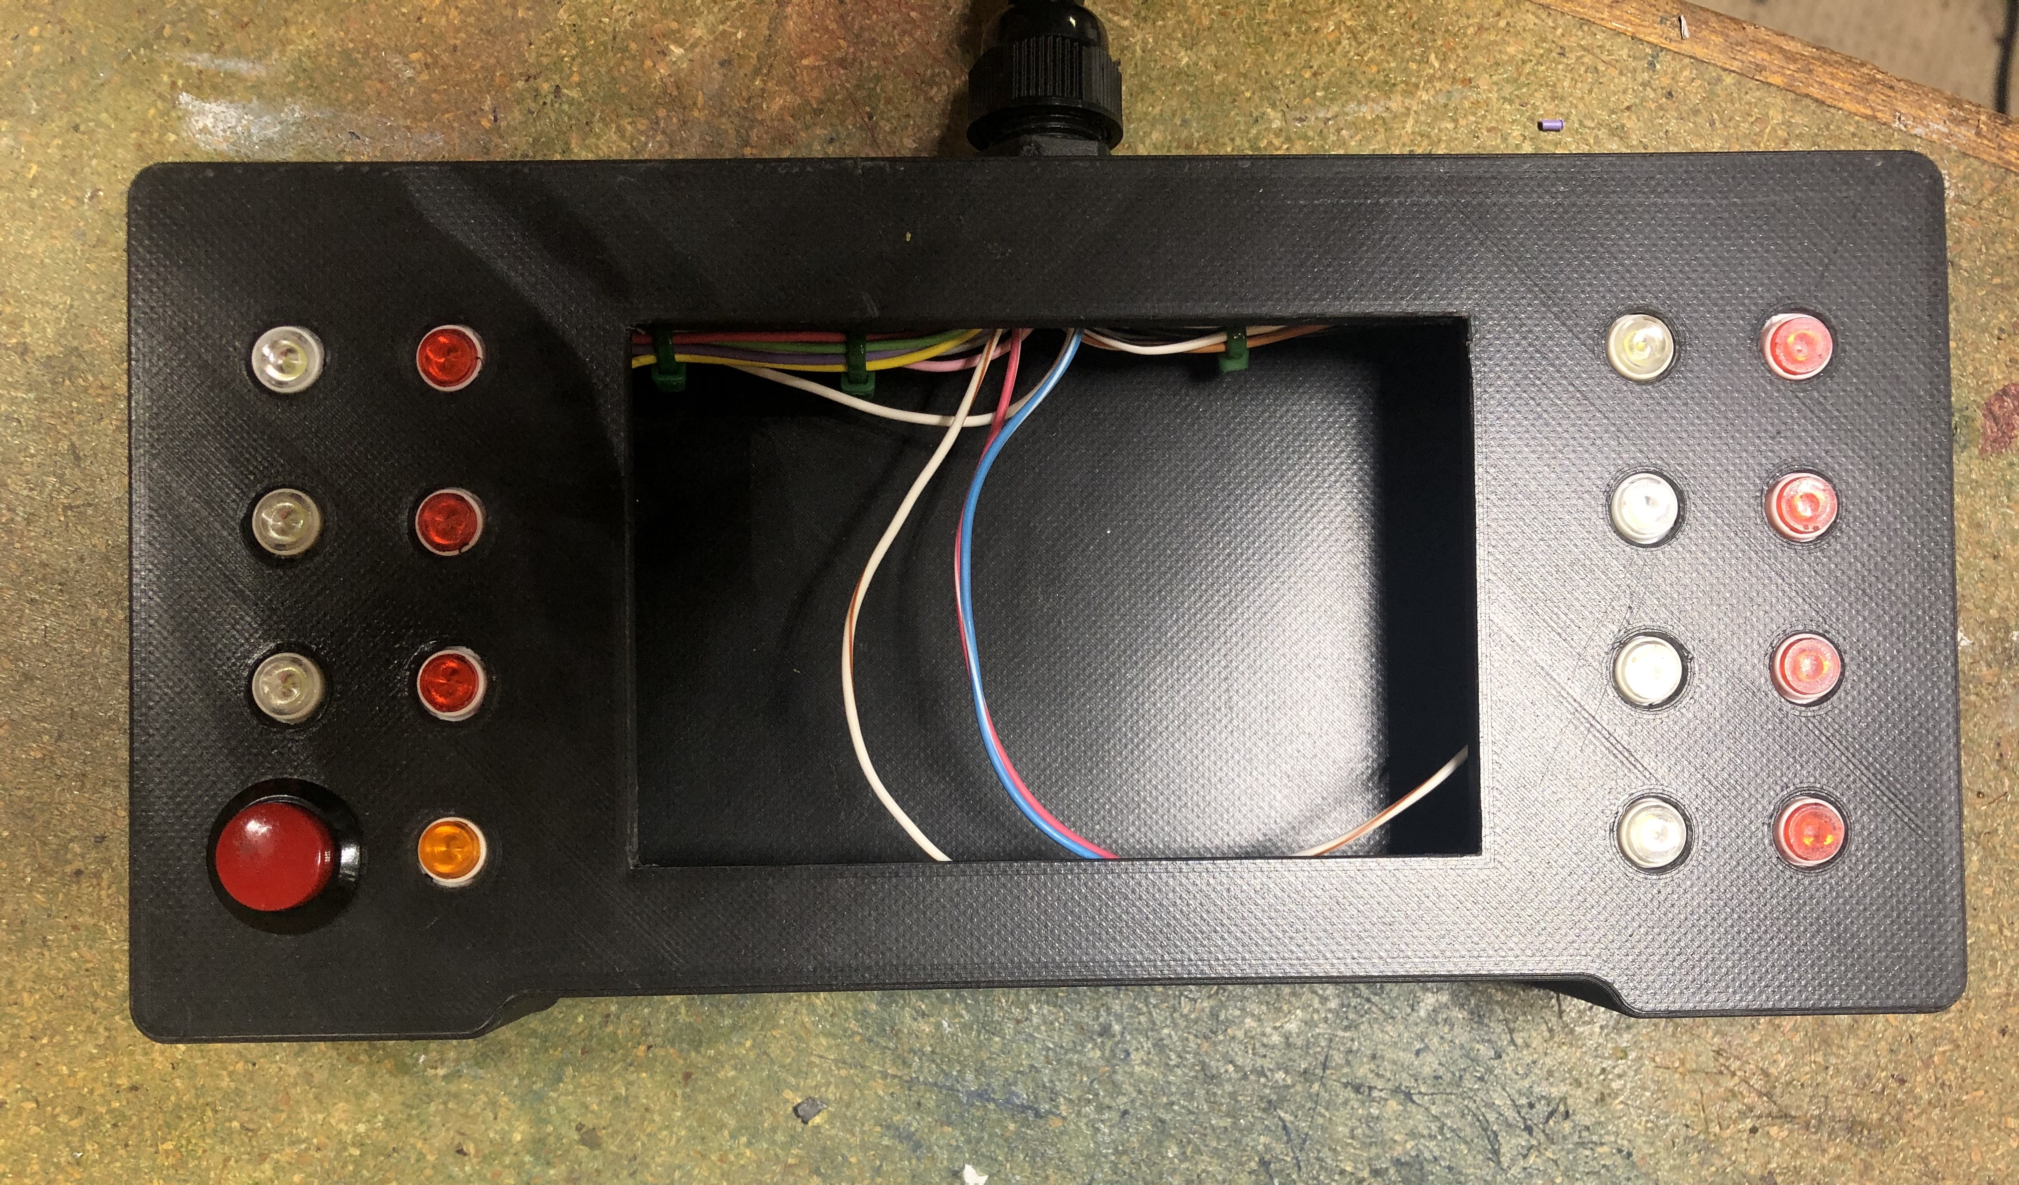
Wiring
Wiring of all components
Bugfixing

Slide 4
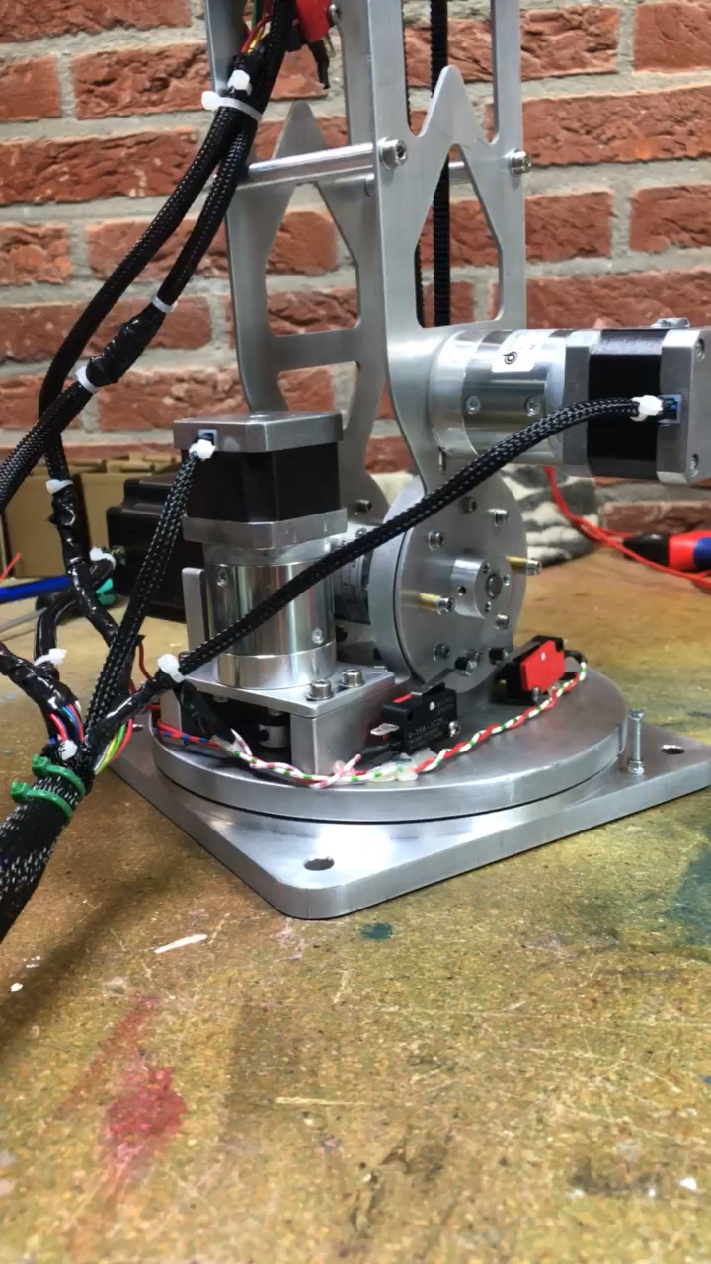
Axis 1

Slide 5
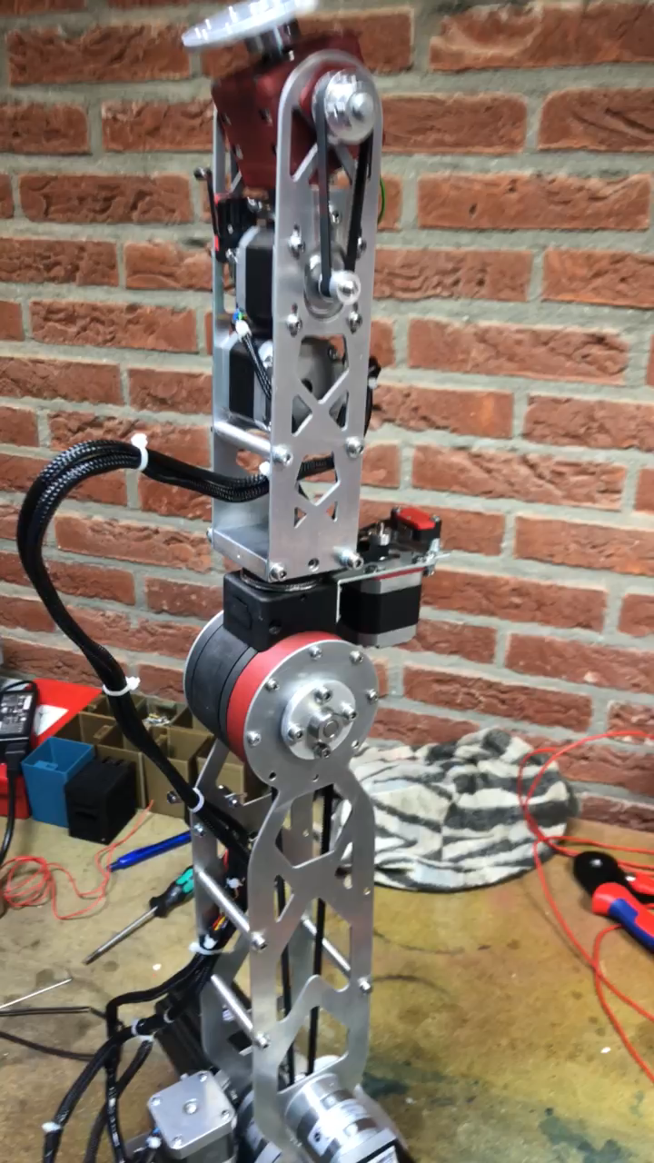
Axis 2

Slide 6
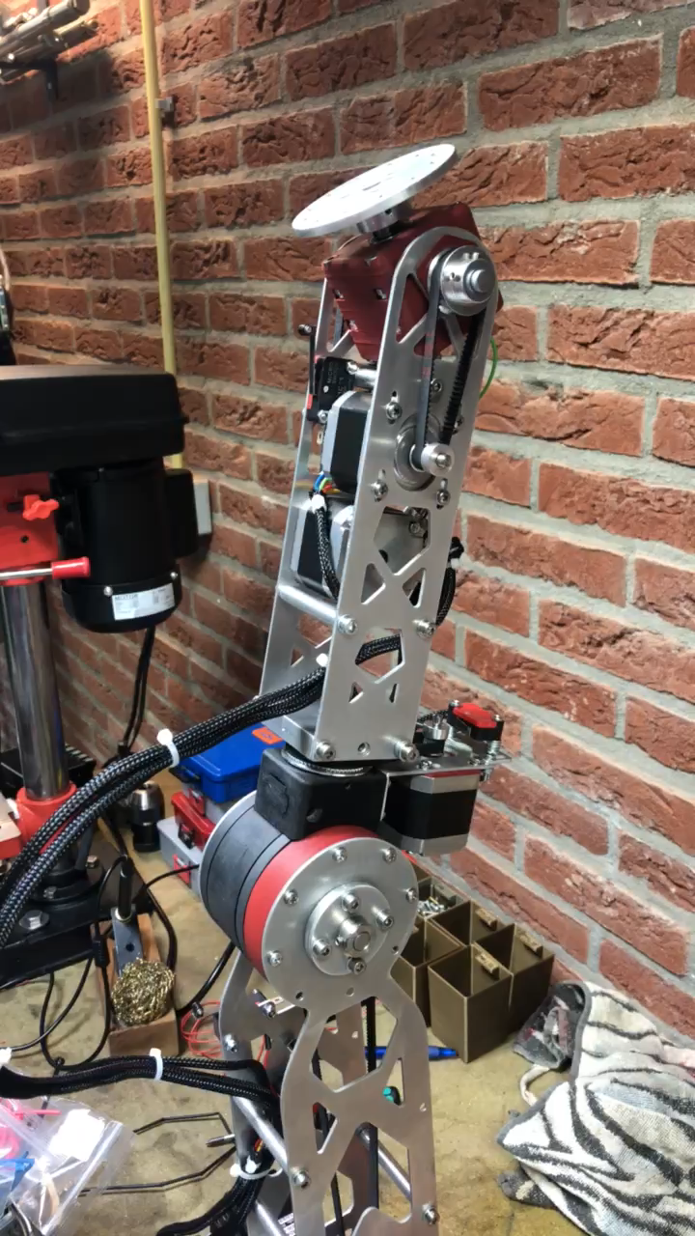
Axis 3

Slide 7
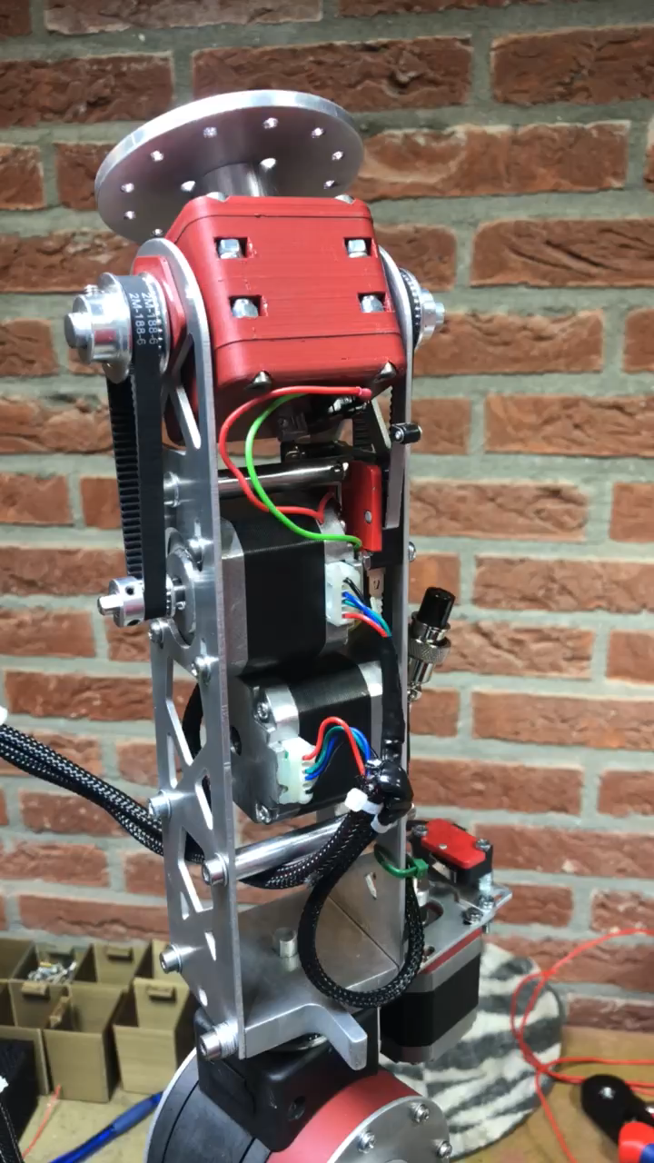
Axis 4

Slide 8
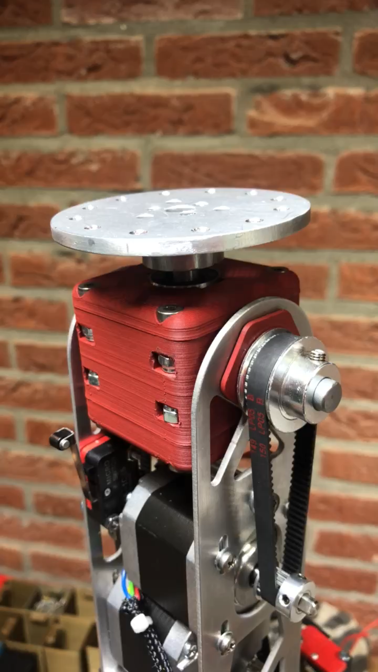
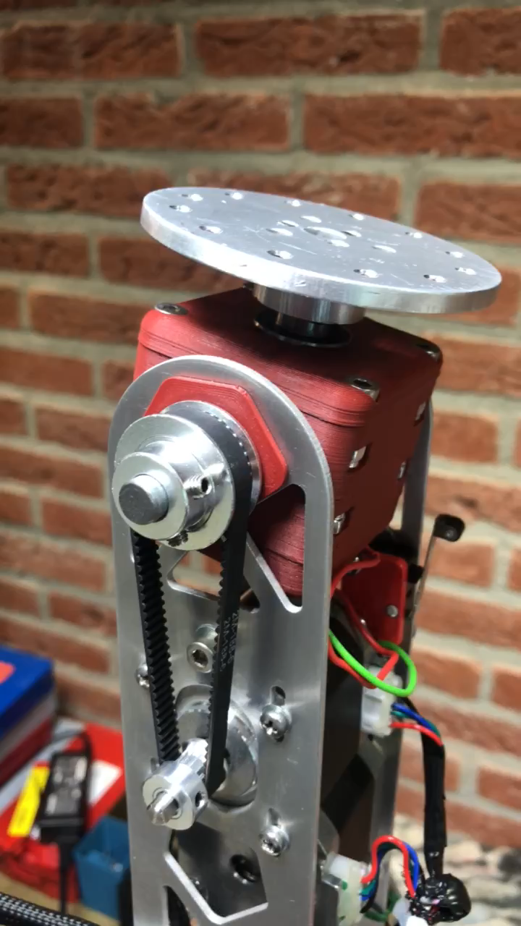
Axis 5 and 6

Slide 9
Next week
Finish programming the robot
Make a video

Slide 10
Questions?

